Slide 1
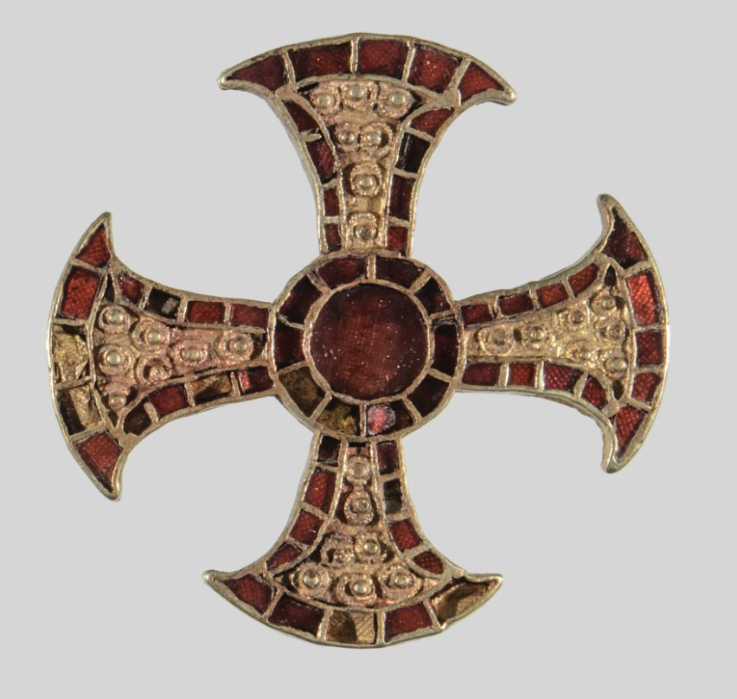
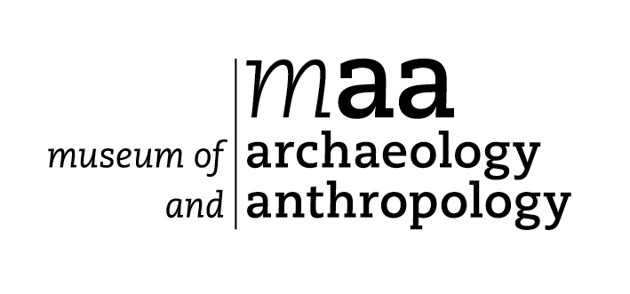
An
Early Medieval bed burial
and the
Trumpington Cross

Slide 2
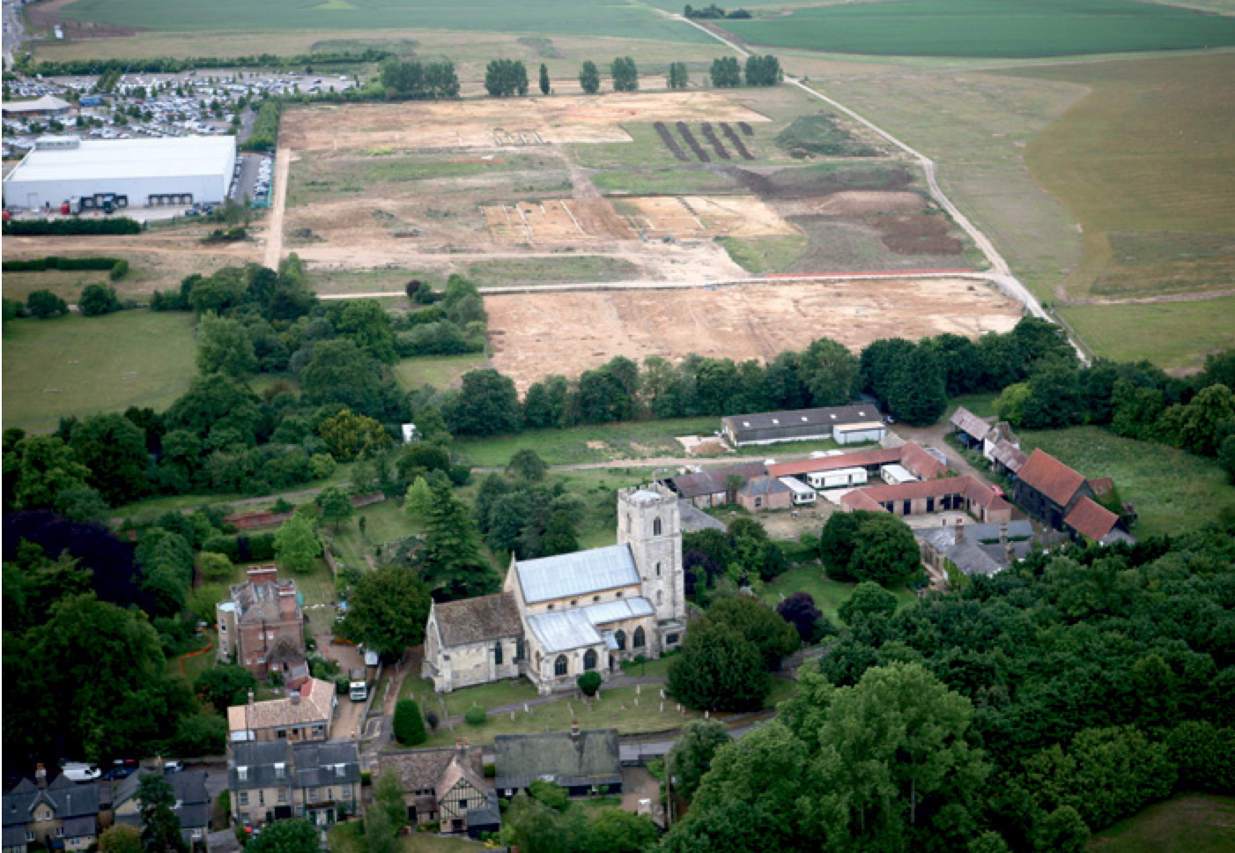
SITE OF THE EXCAVATION AT TRUMPINGTON, CAMBRIDGE
Excavation photographs courtesy of Cambridge Archaeological Unit

Slide 3
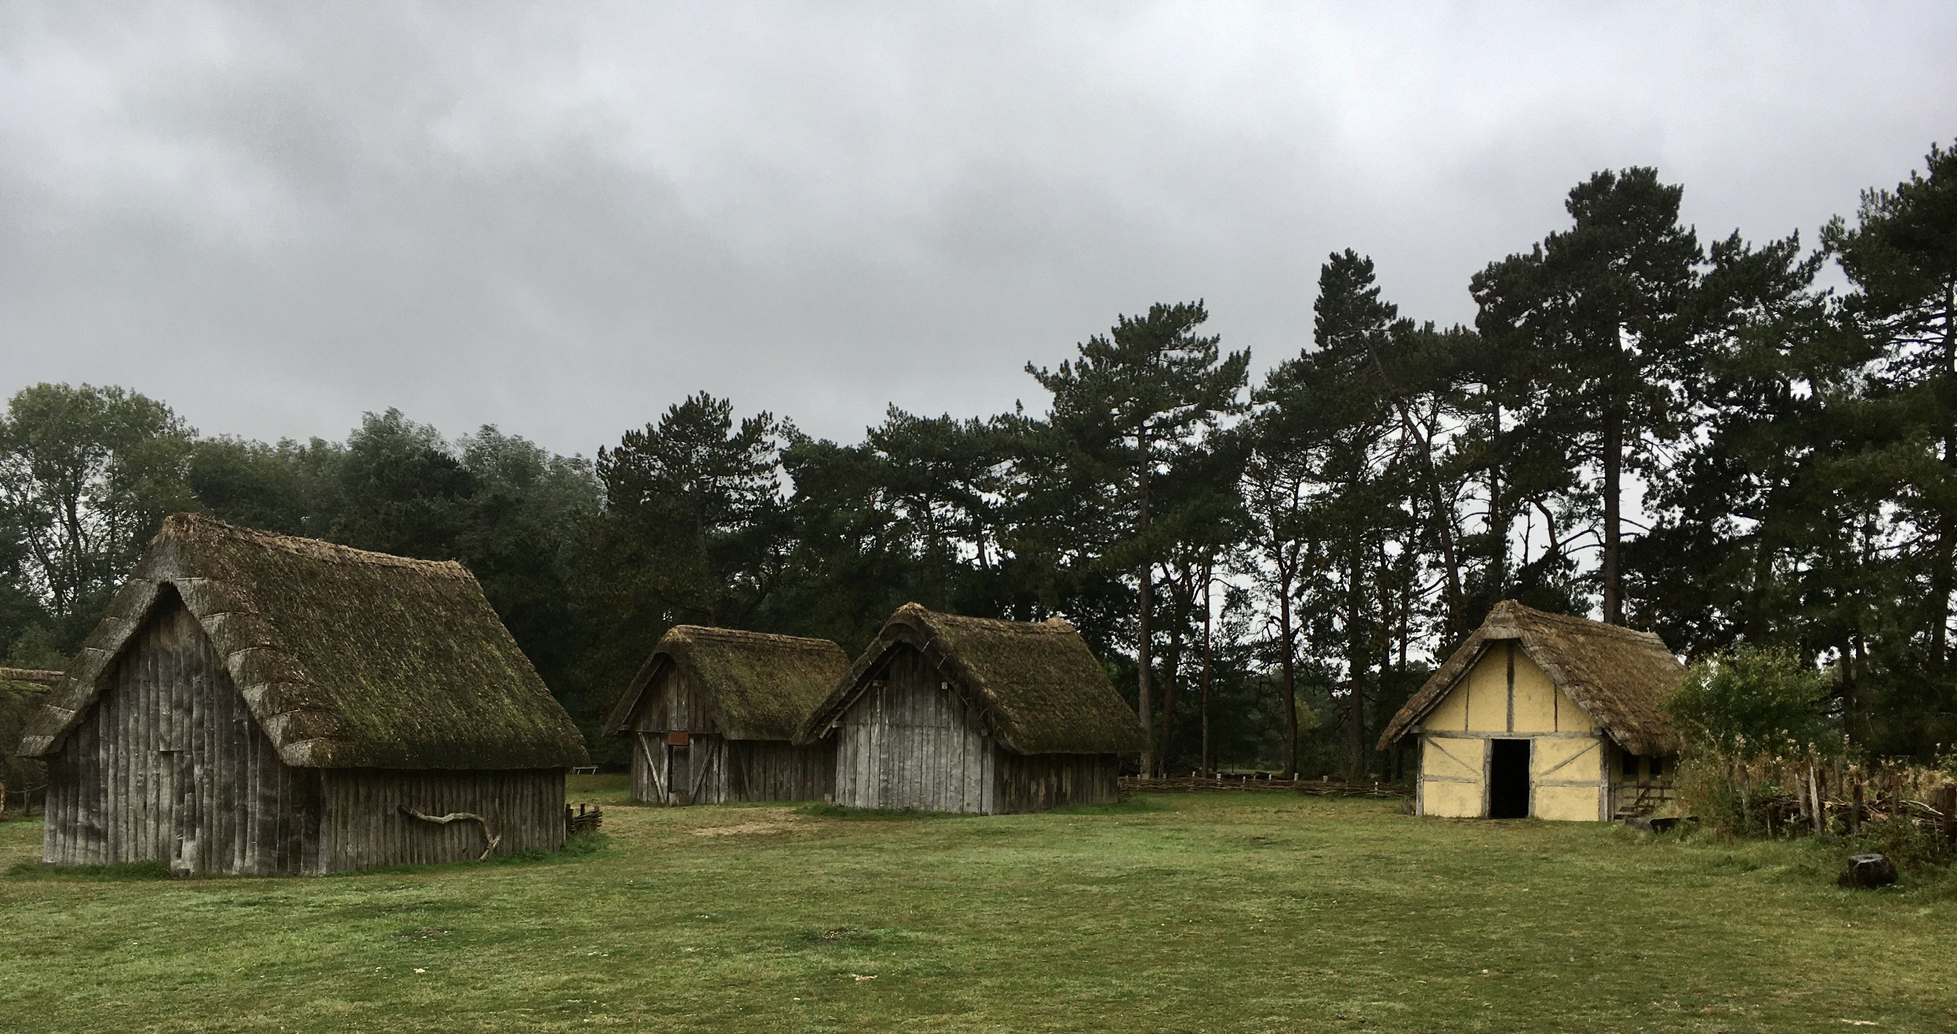
EARLY MEDIEVAL STYLE HOUSES AT WEST STOW, SUFFOLK

Slide 4
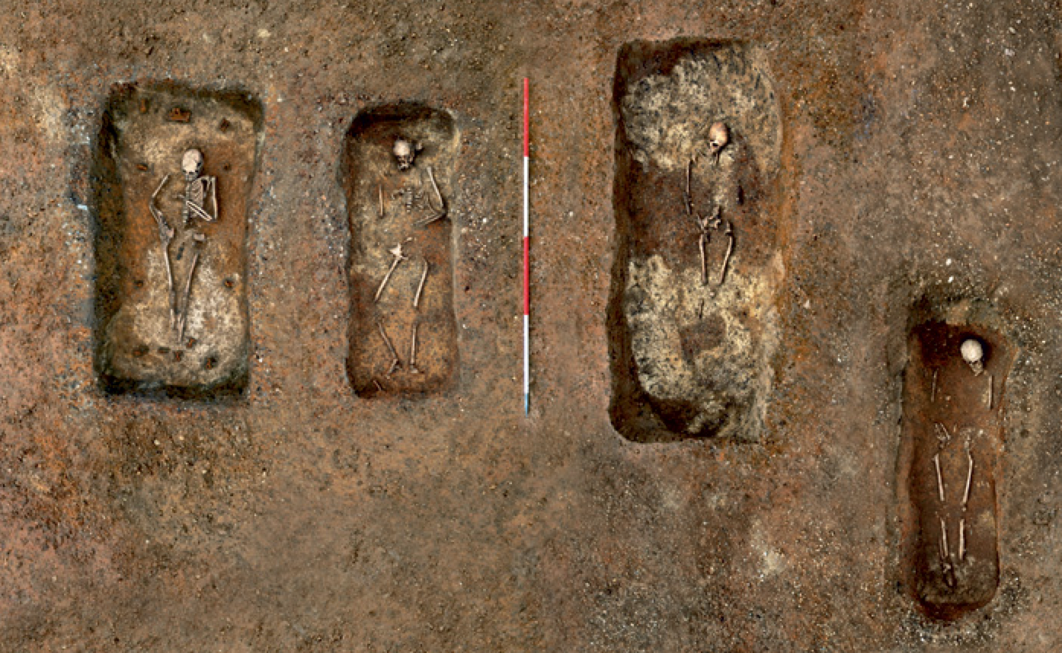
FOUR EARLY MEDIEVAL BURIALS WERE FOUND
AND EXCAVATED
Excavation photographs courtesy of Cambridge Archaeological Unit

Slide 5
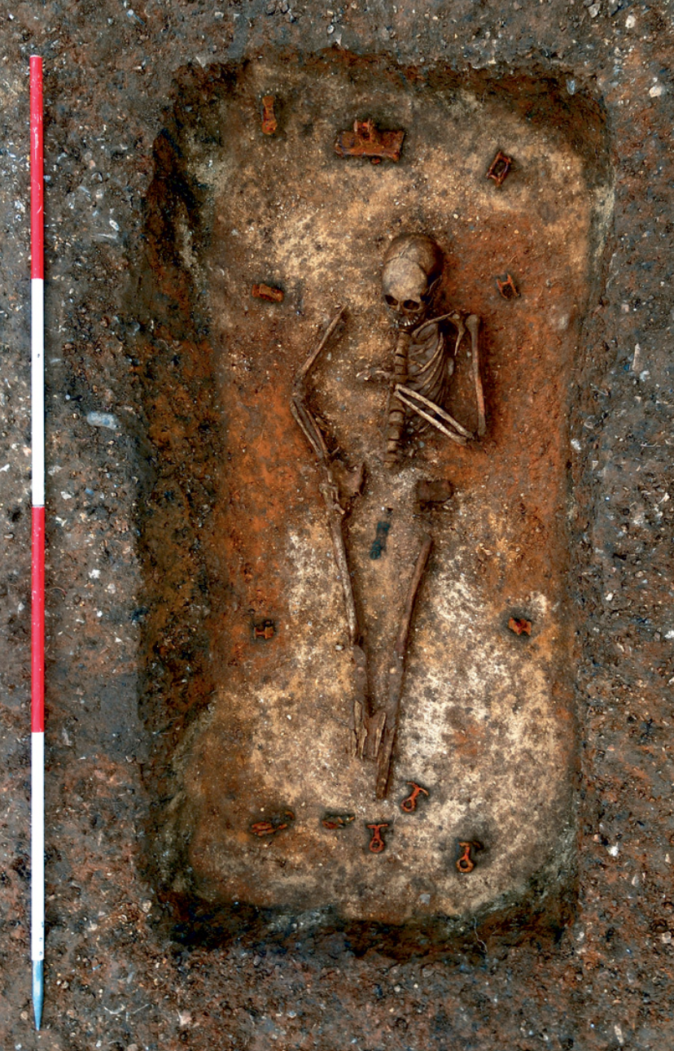
FOUR EARLY MEDIEVAL BURIALS WERE FOUND
AND EXCAVATED
BUT ONLY ONE BODY HAD BEEN PLACED ON A BED
THE BED BURIAL
Excavation photographs courtesy of Cambridge Archaeological Unit

Slide 6
THE BED BURIAL
Excavation photographs courtesy of Cambridge Archaeological Unit

Slide 7
THE BED BURIAL
Excavation photographs courtesy of Cambridge Archaeological Unit

Slide 8
GOLD AND GARNET CROSS
GOLD AND GARNET PINS
WOODEN BED
BEADS
BONE COMB
CHATELAINE
PILLOW
EARLY MEDIEVAL BED BURIAL, TRUMPINGTON

Slide 9
WHAT OBJECTS WOULD YOU HAVE PLACED ON YOUR BED BURIAL?
DRAW AND LABEL THEM ON YOUR WORKSHEET

