Slide 1
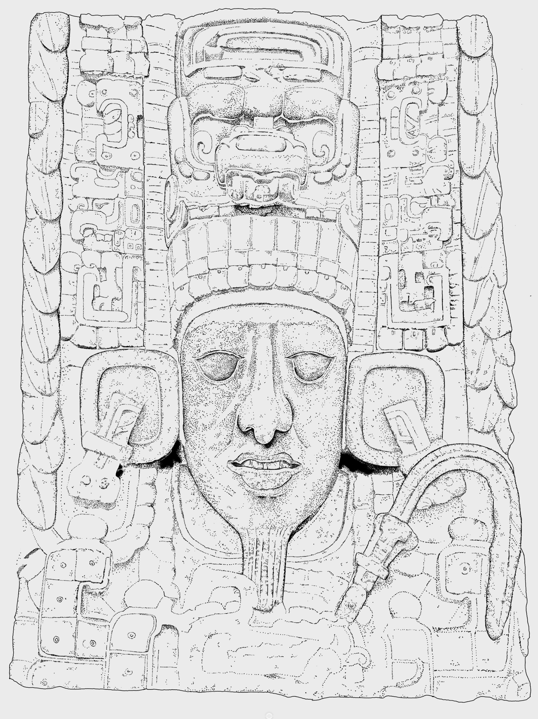
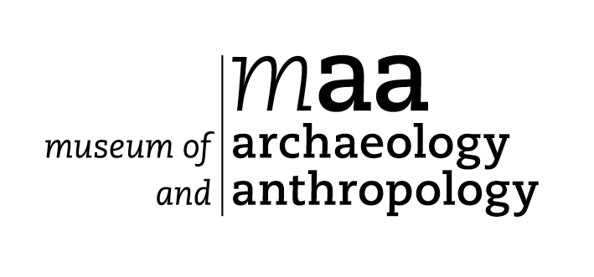
King K’ak’ Tiliw Chan Yopaat
Ruler of the city of Quirigua
from
724 to 785 AD

Slide 2
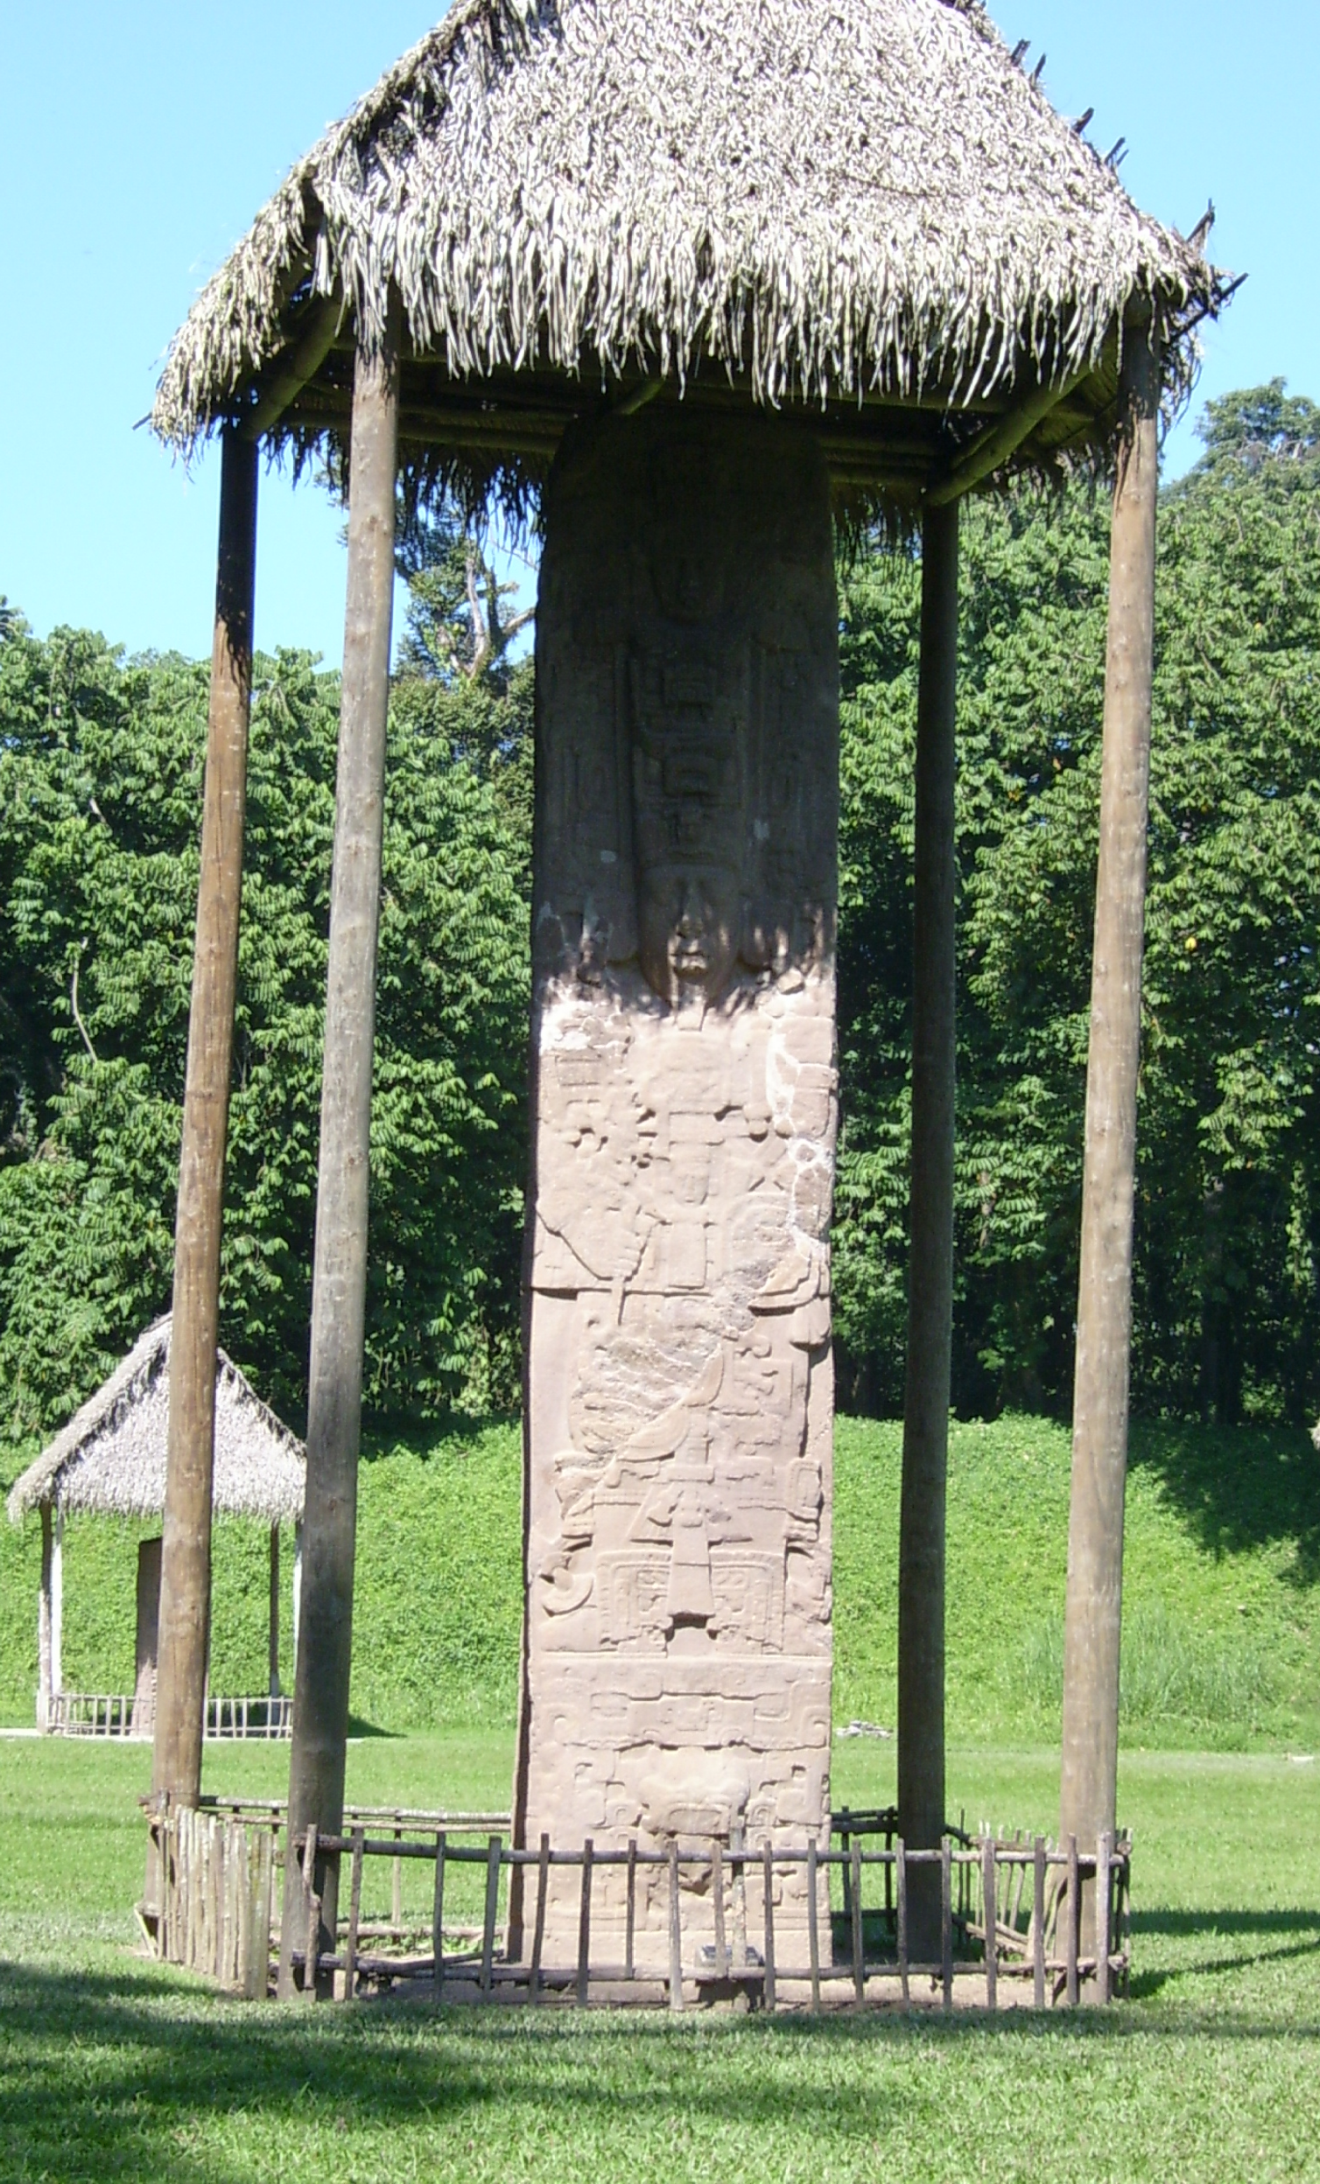
This tall standing stone is called a stela
It stands in the Great Plaza at Quirigua, now part of Guatemala
It has portraits of King K’ak’ Tiliw Chan Yopaat on two sides
It is 35 feet tall and weighs 65 tons

Slide 3
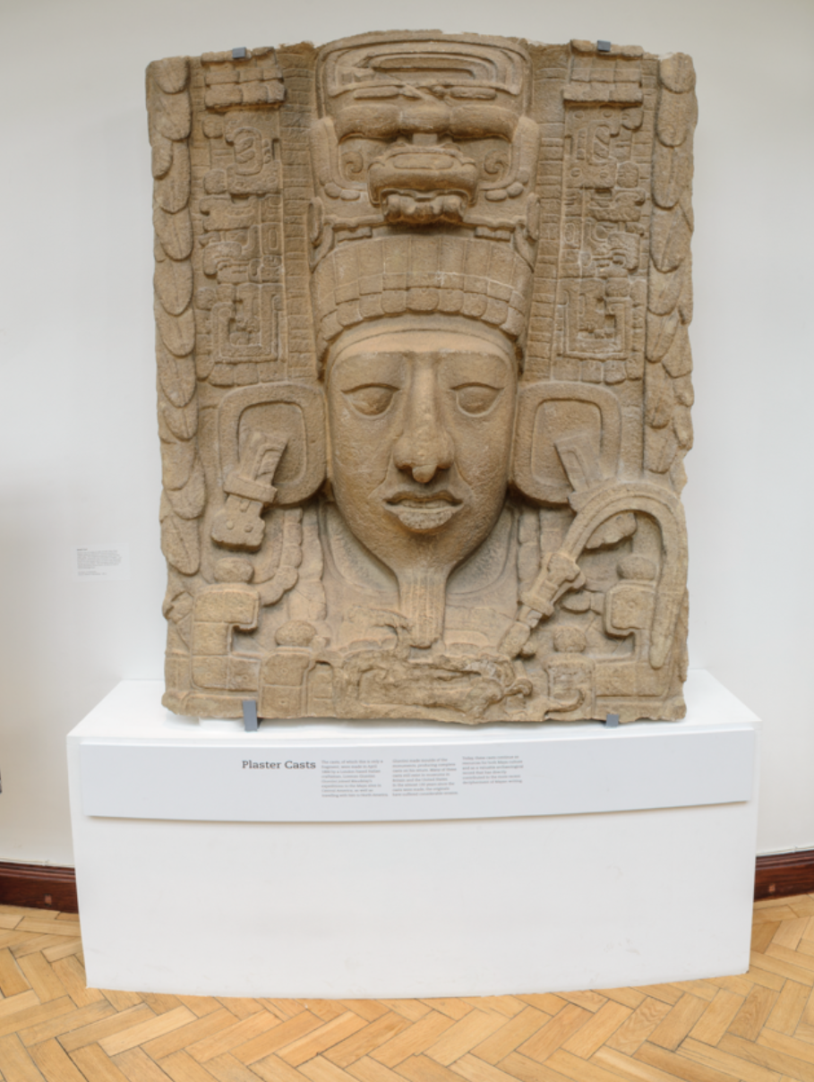
This is a plaster cast of part of the stela
It is on the second floor of the museum
It was made around 1885
It shows one of the portraits of King K’ak’ Tiliw Chan Yopaat

Slide 4
This is a drawing of the cast. It will help us see more detail
Everything in the picture tells us that this is an image of a great Mayan ruler
Let’s look at each part one section at a time

Slide 5
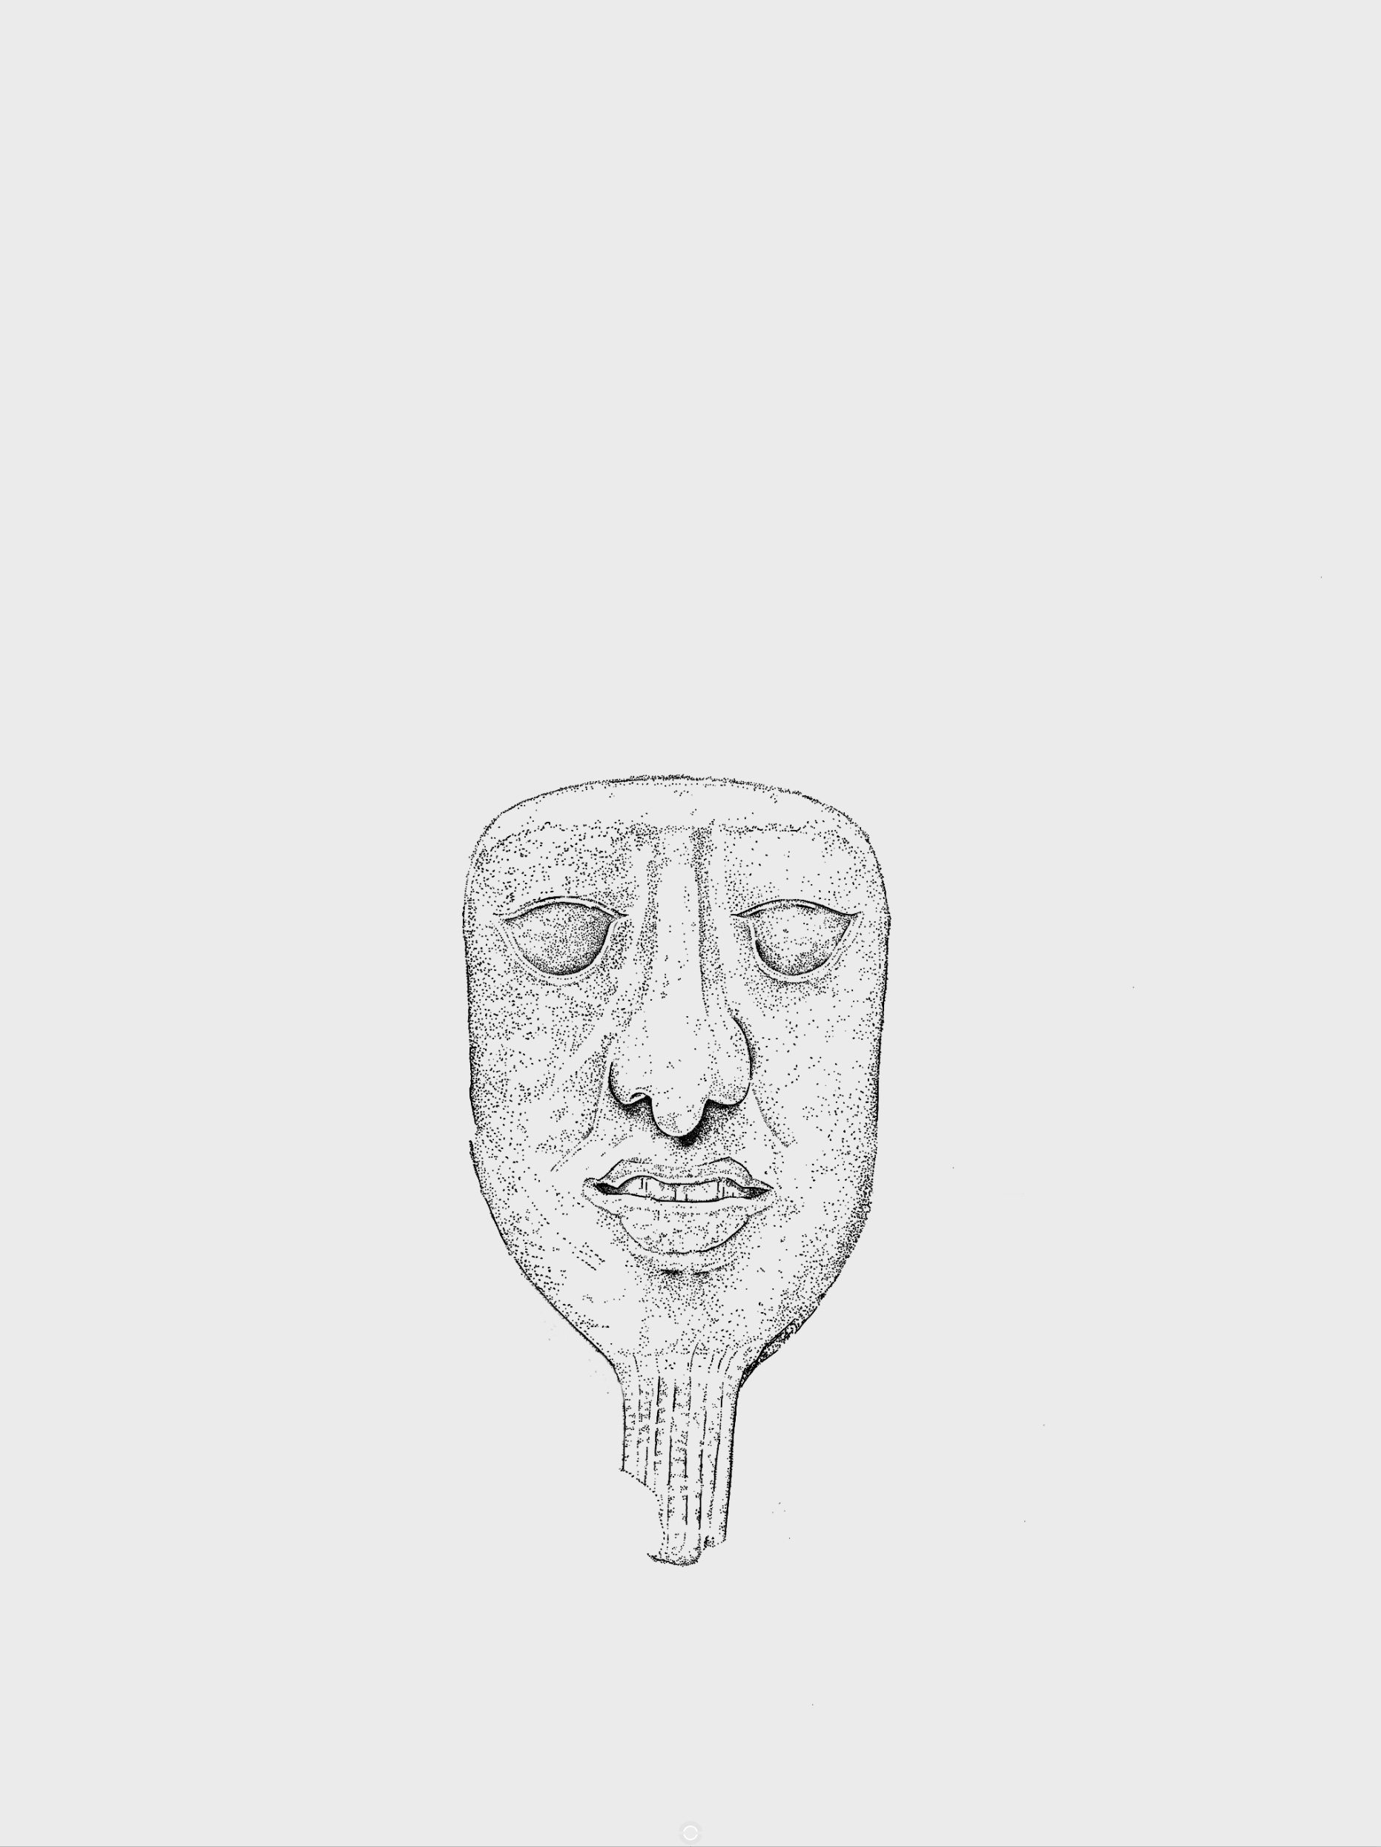
The king has large almond-shaped eyes and a large nose, both
are signs that this is a portrait of a king
The king’s mouth is slightly open and he has a narrow beard,
again signs that this is a portrait of a king
Did you know that the Ancient Maya believed their souls lived in
their noses? We might point at our chest and say, “Are you talking to
me?” whereas the Ancient Maya would point to their nose.

Slide 6
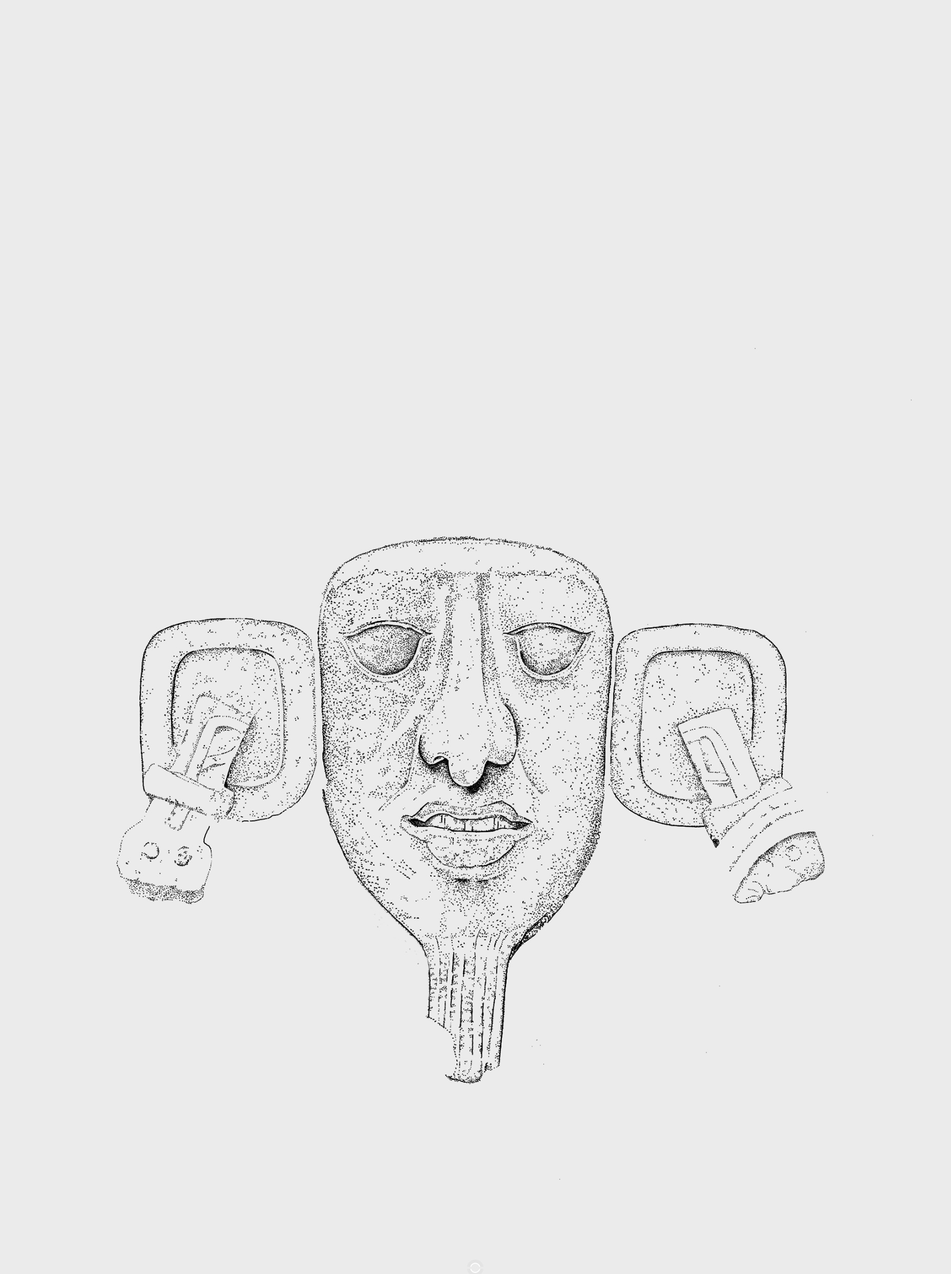
The king’s ears have been stretched by wearing ear spools made of jade and obsidian
Do you know the colour of these materials and where they come from?
Did you know that the Ancient Maya believed that jade was a
living thing?

Slide 7
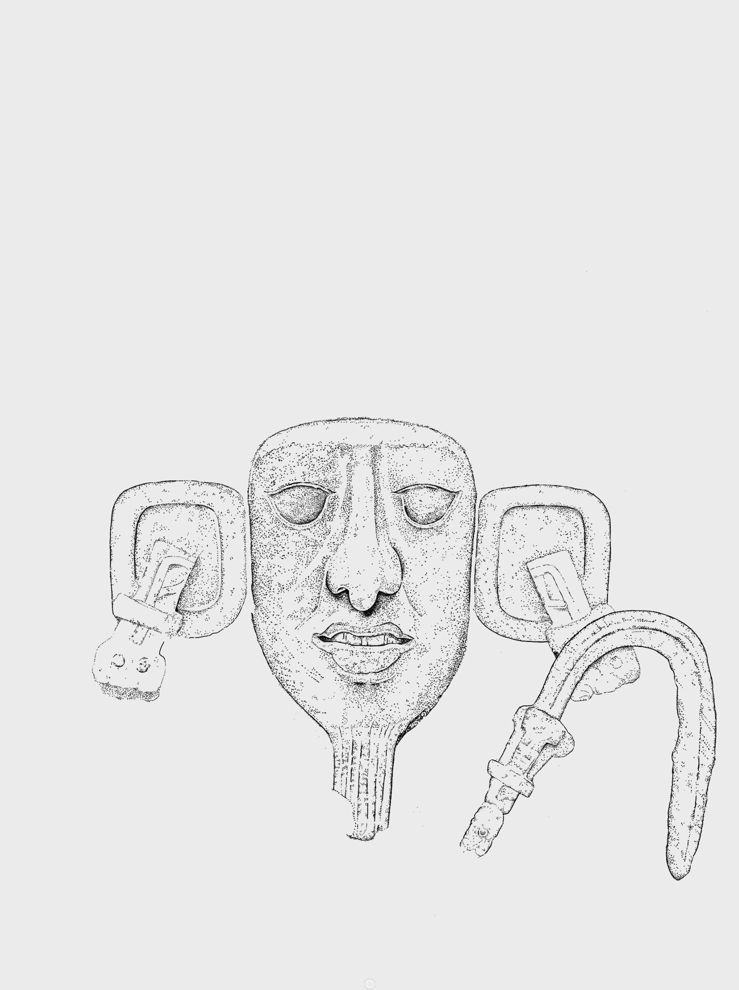
This is a staff with feathers attached. They come from a bird
whose feathers could only be worn by rulers and priests
Do you know what type of bird this was?

Slide 8
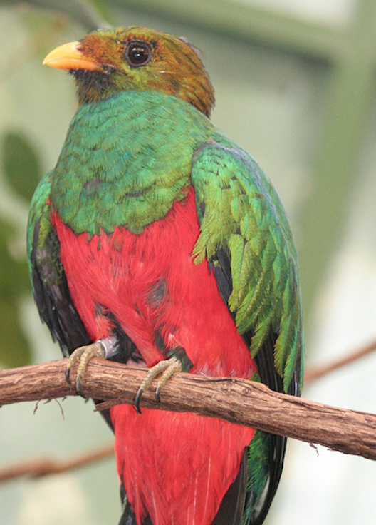
This is a staff with feathers attached. They come from a bird
whose feathers could only be worn by rulers and priests.
Do you know what type of bird this was?
A Quetzal

Slide 9
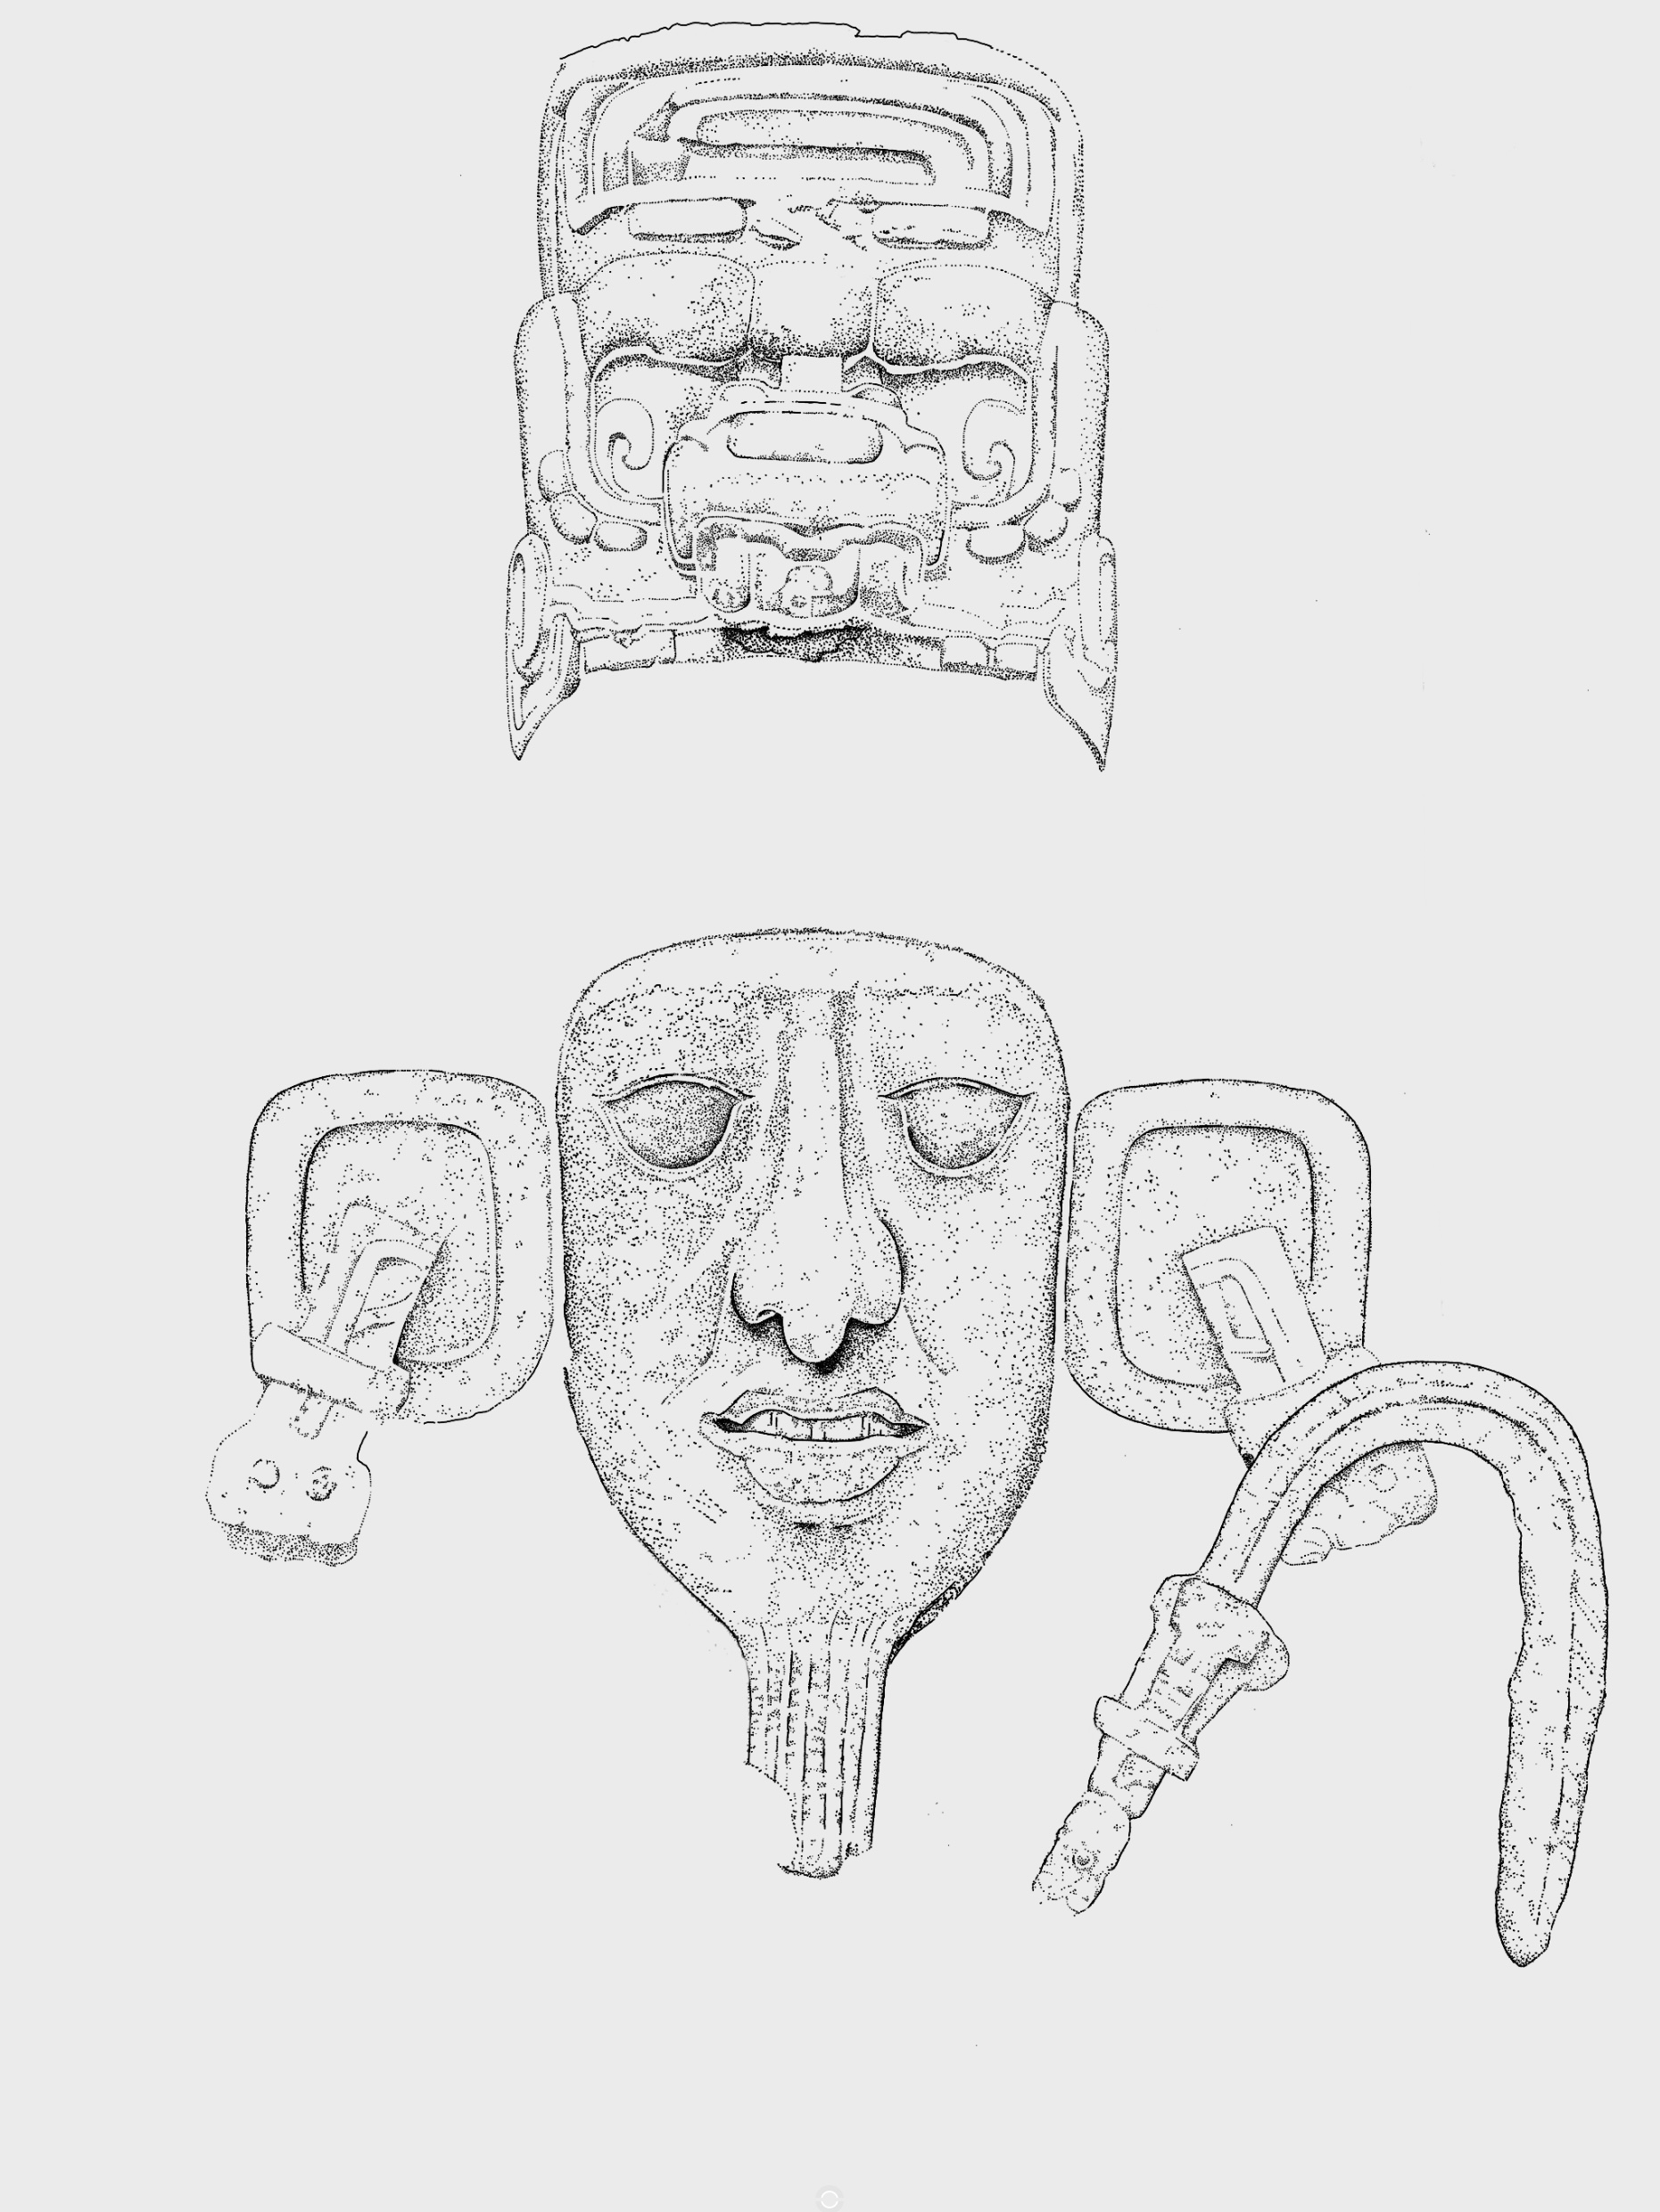
This is the king’s headdress. It’s made to look like a creepy god or an animal from the underworld
It reminds us that the king is such a brave and powerful
ruler that he’s not scared of anything!

Slide 10
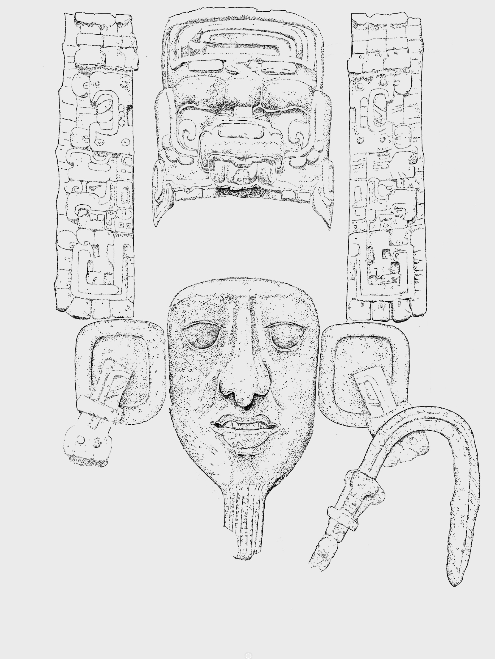
These are glyphs, which are pictures used to tell a story.
The Ancient Egyptians also used pictures to tell stories.
Do you know what we call them?

Slide 11
These are glyphs, which are pictures used to tell a story.
The Ancient Egyptians also used pictures to tell stories.
Do you know what we call them?
Hieroglyphs

Slide 12
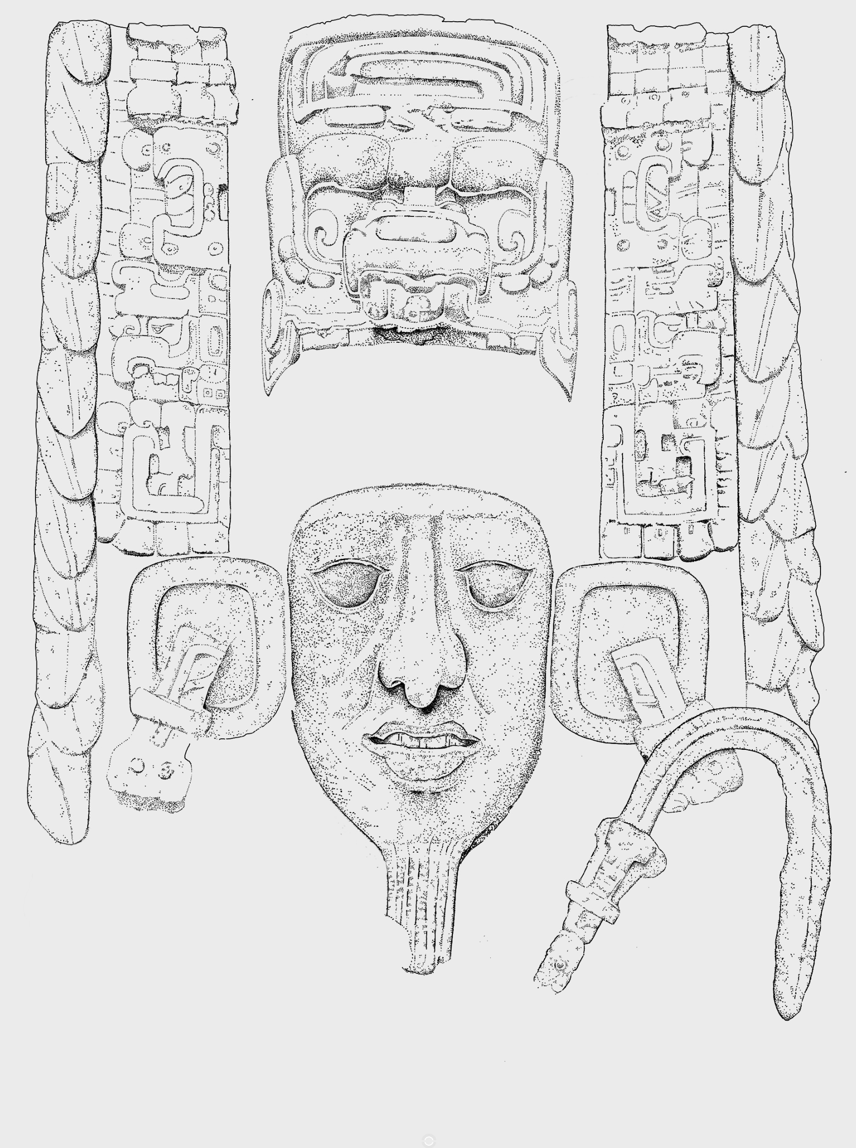
Any idea what these are?

Slide 13
Any idea what these are?
That’s right, they’re feathers from the Quetzal
Did you know that the Ancient Maya never killed a Quetzal
for its tail feathers? They just plucked one or two and let
the bird go free!

Slide 14
So now we know why this is a carving of a king
Can you remember what each part is and what it tells us?

